Slide 1

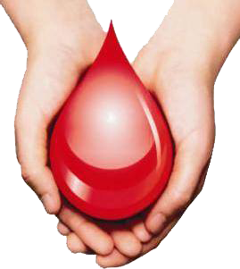
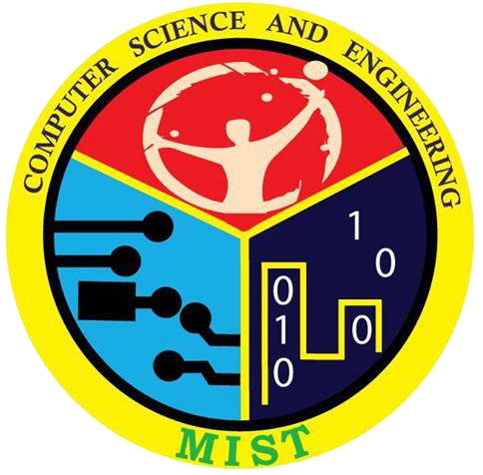
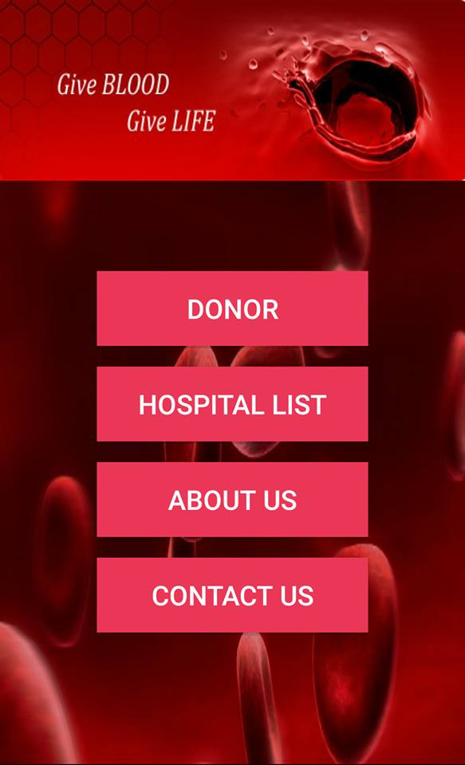
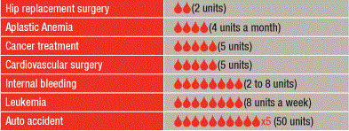
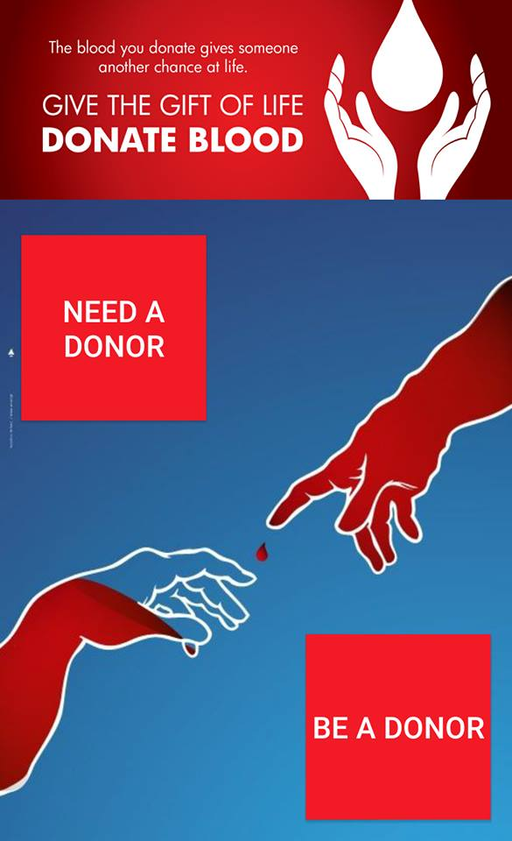
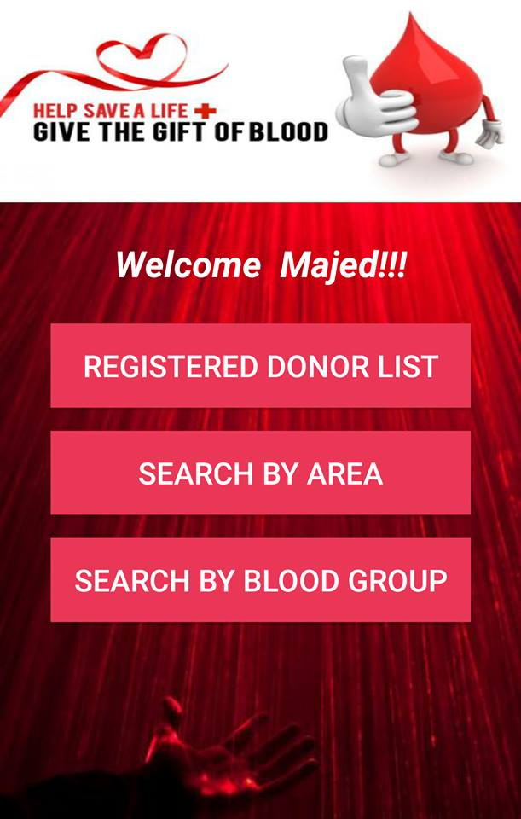
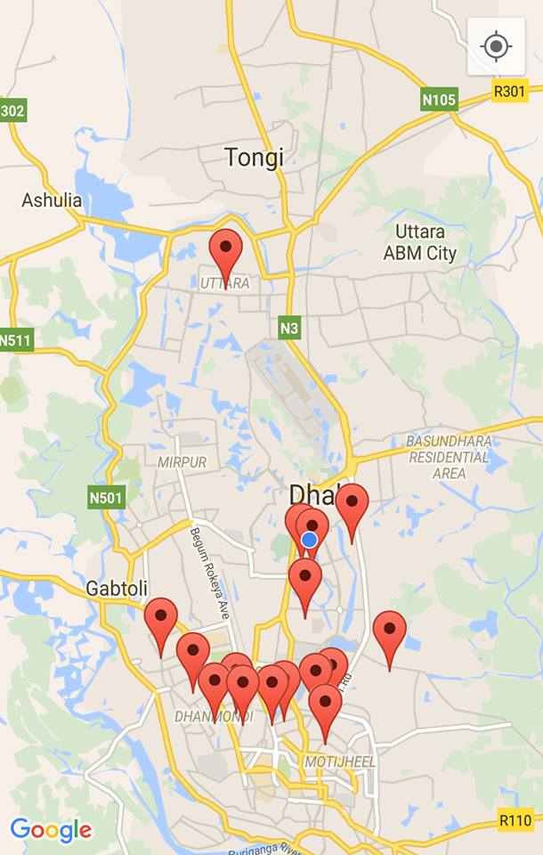
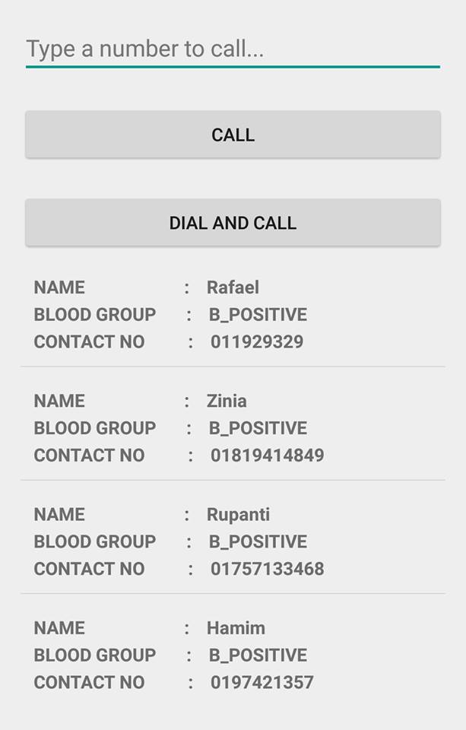
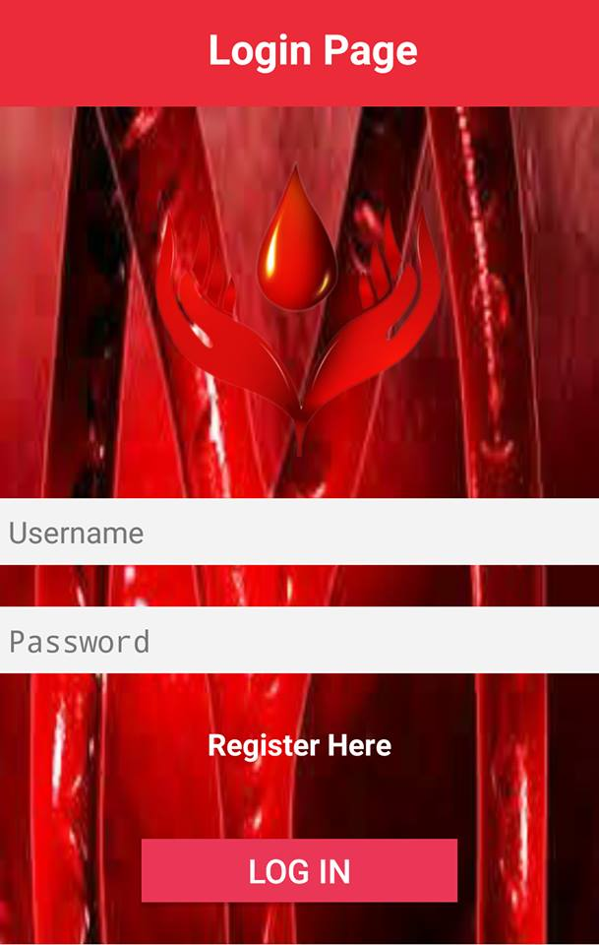
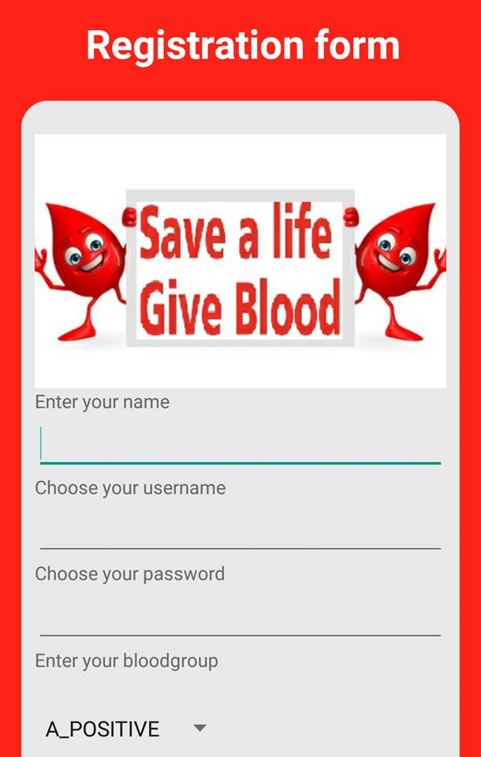
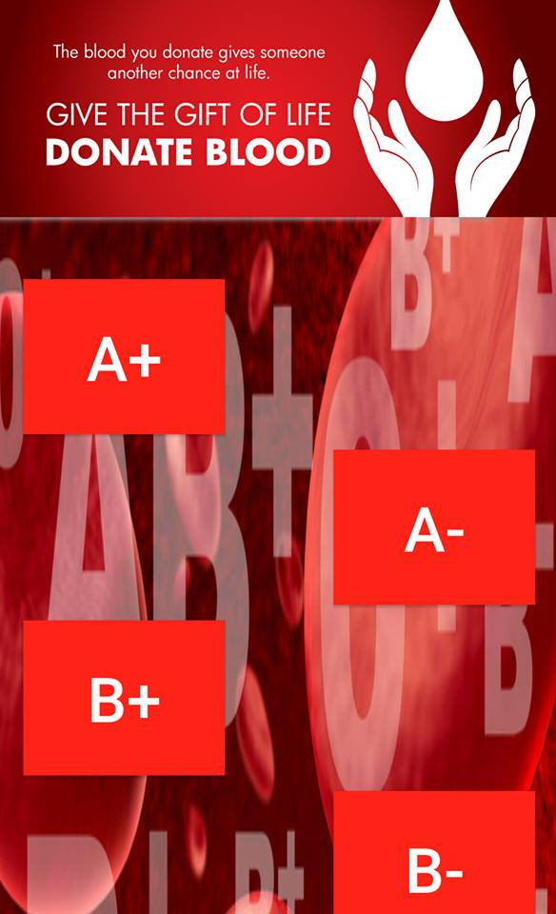
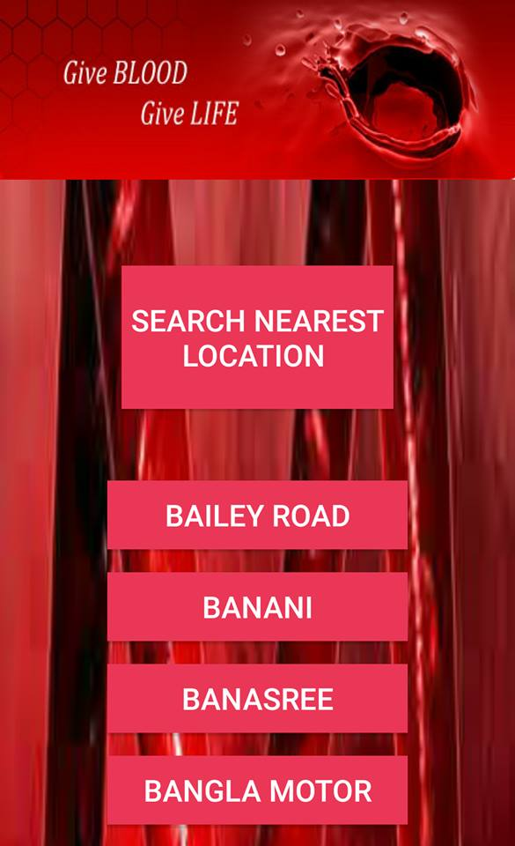
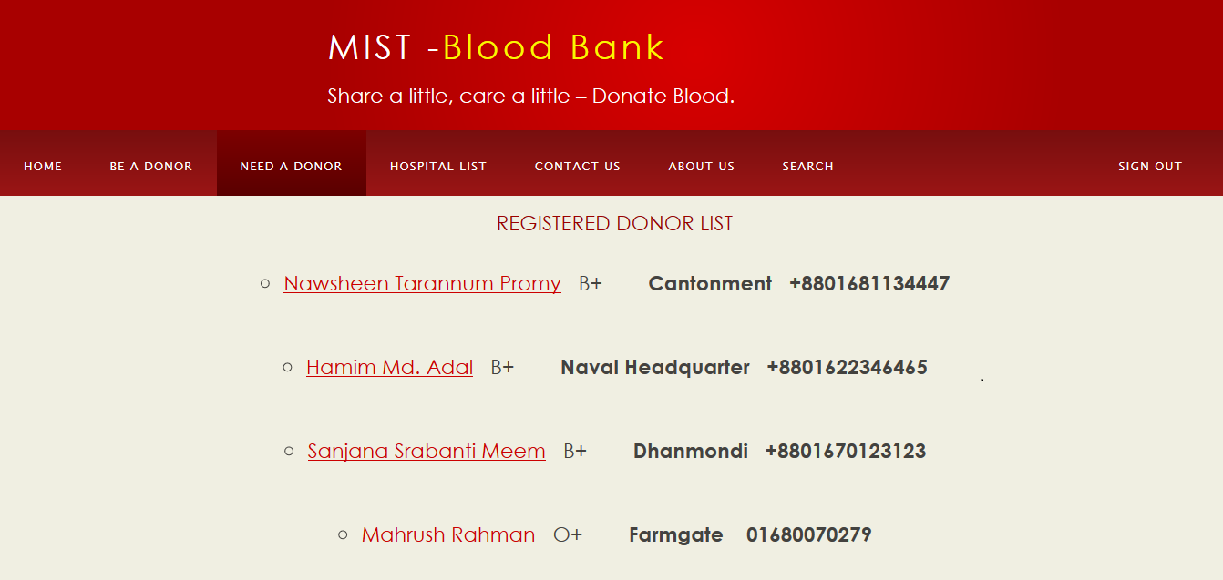
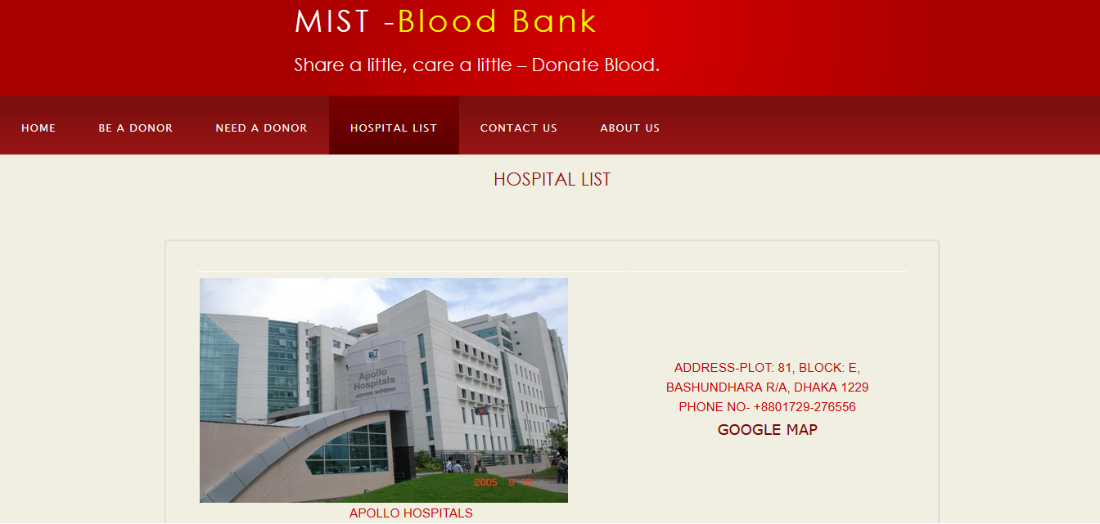
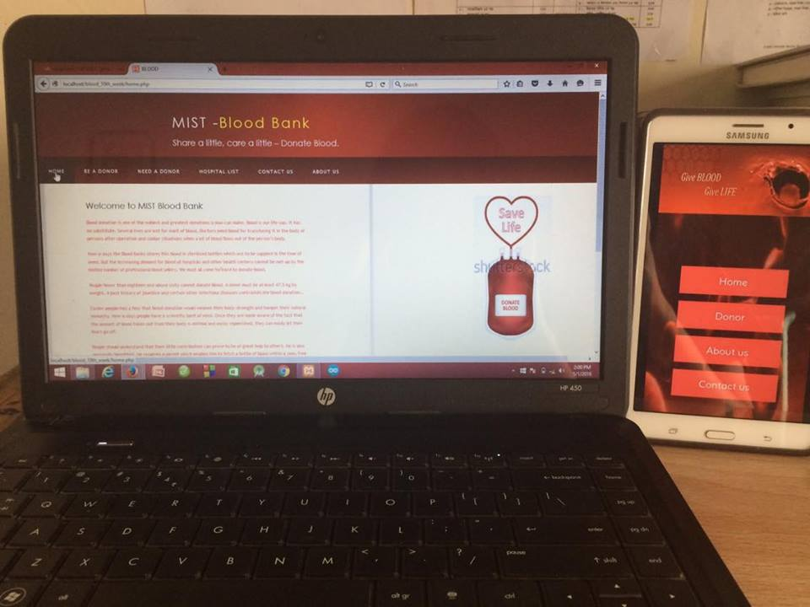
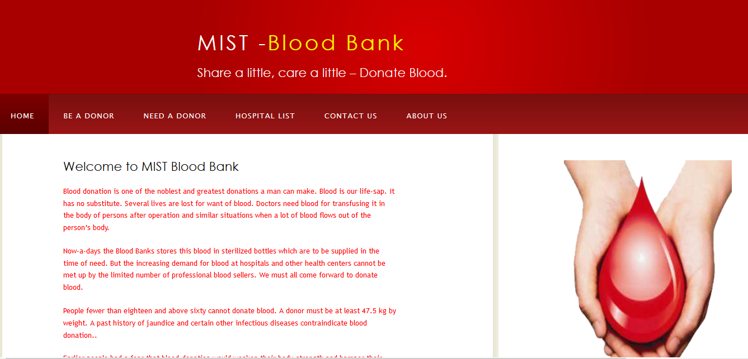
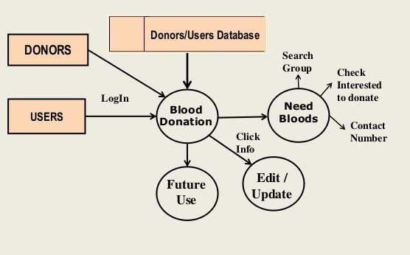
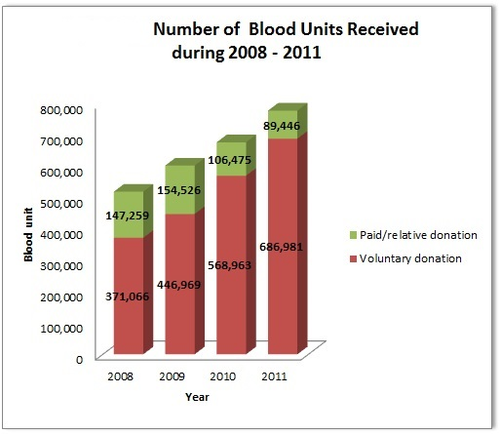
MIST BLOOD BANK
Sanjana Srabanti , Hamim Mohammad Adal and Nawsheen Tarannum Promy
DEPARTMENT OF COMPUTER SCIENCE AND ENGINEERING
MIST
ABSTRACT
METHODOLOGY
TARGET USER
Looking for the perfect blood donor with matching blood group becomes a very dreadful task in the very last moment. For that reason many Blood Bank Applications have made. Some are very efficient, some are not. The aim of these apps is that they will give the suffered people looking for blood access to all the available donors nearby. They also allow willing volunteers to register for donor ship so that people can find them easily when in need. Save time, save your close ones.
User has to create an account.
All the requirements of a donor is saved in the database after the submission of the registration form.
User can see the hospital list and registered donor list.
User can search the donor area wise and blood group wise.
User can directly call the required donor through this app.
User can see the donor’s location through the map.
All this things can also be done through our web.
The problem is not insufficient number of donors, but finding a willing donor at the right time. We want to build a network of people who can help each other during an emergency. Instead of just providing people who need blood with an outdated list of regular donors who may or may not be available to help, Through our mobile application people can contact the right people the moment they find out about the need.
Working Procedure of MIST BLOOD BANK App:
Table-II : Necessity of blood in daily life
INTRODUCTION
A life may depend on a gesture from you, a bottle of blood. A blood bank is a cache or a bank of blood or blood components, gathered as a result of blood donation or collection, stored and preserved for later use in blood transfusion. The blood bank application is a platform where user can find out the required type of blood in the shortest possible time.
This project consists of an application which is present on the donors’ android-phone, a website which acts as an interface for the users of the system and it also uses hosting for storing the donor’s data.
OBJECTIVES
Required Fields
The blood bank application’s purpose is to meet the challenging requirement of modern day blood to efficiently collect blood during emergency.
It aims at bringing the donor under one roof so that user can find them easily without any waste of time.
User can also get informed about the availability of stored blood and blood components in various hospitals.
Users can get information about donors and the hospitals located nearby their location and can contact them by the numbers provided in the application.
Search Options
Showing Nearest Blood Donors
Direct Call Option
FEATURES
FUTURE EXPANSIONS
Search Option:
There will be a search option in case of searching the types of blood and also for the availability of blood in various hospitals. User also can search for donors.
How to become a donor:
There will be a donor registration form. If anyone wants to be a donor he/she has to fill up and submit the form.
Donor List:
There will be a list of registered donors. Users can see the donors name, blood group, contact number, email id and area.
Blood available in the hospitals:
Users can see the availability of different types of blood in various hospitals.
Calling Option:
User can call the donor through our app.
Map Allocation:
User can see the location of donor and hospital.
Donor can get notification when they are again suitable after 3 months later giving previous time blood.
Activate - deactivate button will be added for donor.
Direct communication between users and doctors through email.
We will expand it for the whole country.
Registration Form
Search by Blood Group
Search Nearest Location
CONCLUSION
Working Procedure of MIST BLOOD BANK Web:
The conclusion is that the system which will help in better interaction between the blood receivers and the blood donors and also with the hospitals that store blood. This application will encourage donors to donate blood. Blood donation is our human duty.
ACKNOWLEDGEMENT
First of all we are thankful to our Computer Science and Engineering Department. Then we will thankful to Sandhani Blood Bank Bangladesh for their tremendous support.
Registered Donors
Hospital List
SUPERVISORS
We are grateful to our respected teachers for giving us their logistical support and providing necessary guidance concerning projects implementation.
Dr. Khondaker Abdullah Al Mamun
Lt Commander S M Anisur Rahman
Lecturer Sanjida Nasreen Tumpa
Lecturer Rubyeat Islam
Fig 1. MIST BLOOD BANK web and mobile application
TOOLS
HTML: We developed our web page with the help of HTML(Hypertext Markup Language).
CSS: Cascading Style Sheets (CSS) is a style sheet language used for describing the presentation of a document written in markup language
PHP: PHP is a general purpose scripting language that is specially suited to web development. We used it for our back-end.
ANDROID STUDIO: Android studio is the official integrated development environment for android platform development. We used it for our app development.
REFERENCES
http://www.redcross.org/m/mobile-apps/eula
http://www.badhan.org
http://www.centralbloodbank.org
Fig 2. Flow Chart of MIST Blood Bank Application
Fig 3. Increased rate of blood donor and recipient

